Slide 1
Rethinking meta-analysis purpose
Adrien Fillon
TWIN4MERIT summer school
September, 9, 2025

Slide 2
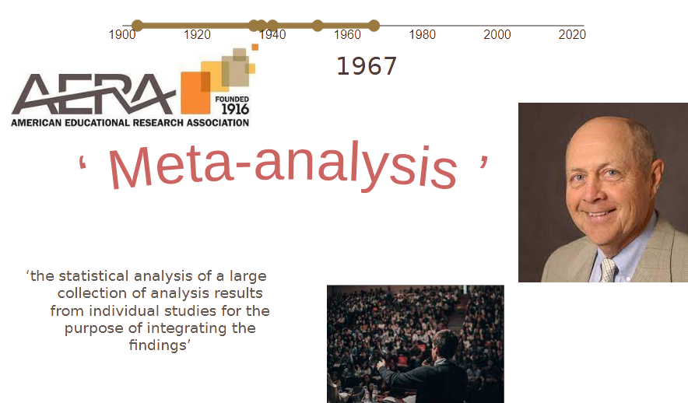
Notes:
Gene Glass

Slide 3
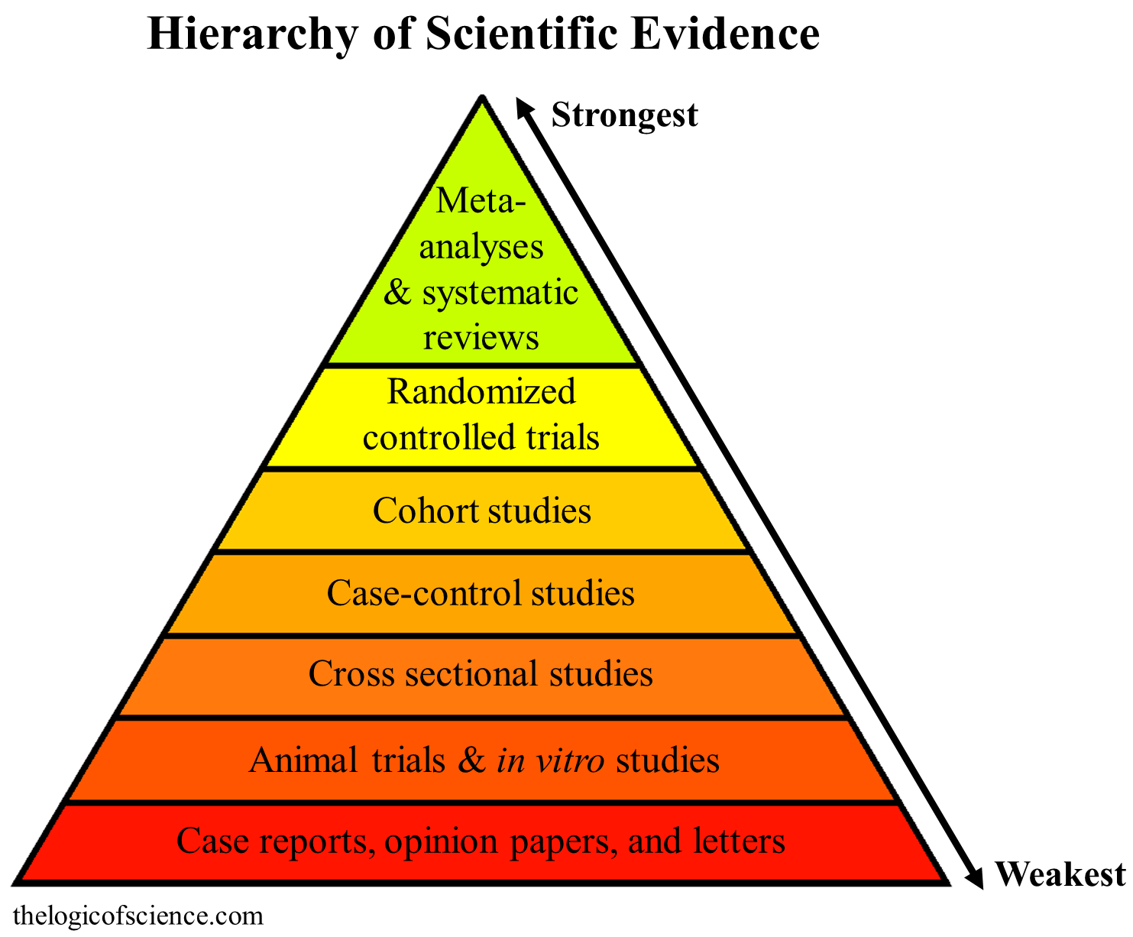


Slide 4
What is the purpose of meta-analyses?
Traditionally : assess effect size of a particular effect (whatever standardized it is)
Fixed-effect meta-analysis
Test if an effect exists and is consistent in the literature
P-value of difference with 0

Slide 5
First problems
Researchers don't standardise their practices
In the selection of participants
In design
In measures
When reporting their results
Etc.
Very high heterogeneity not solely due to "measurement errors"
In a leap of faith: moved from Fixed to Random effect modelling

Slide 6
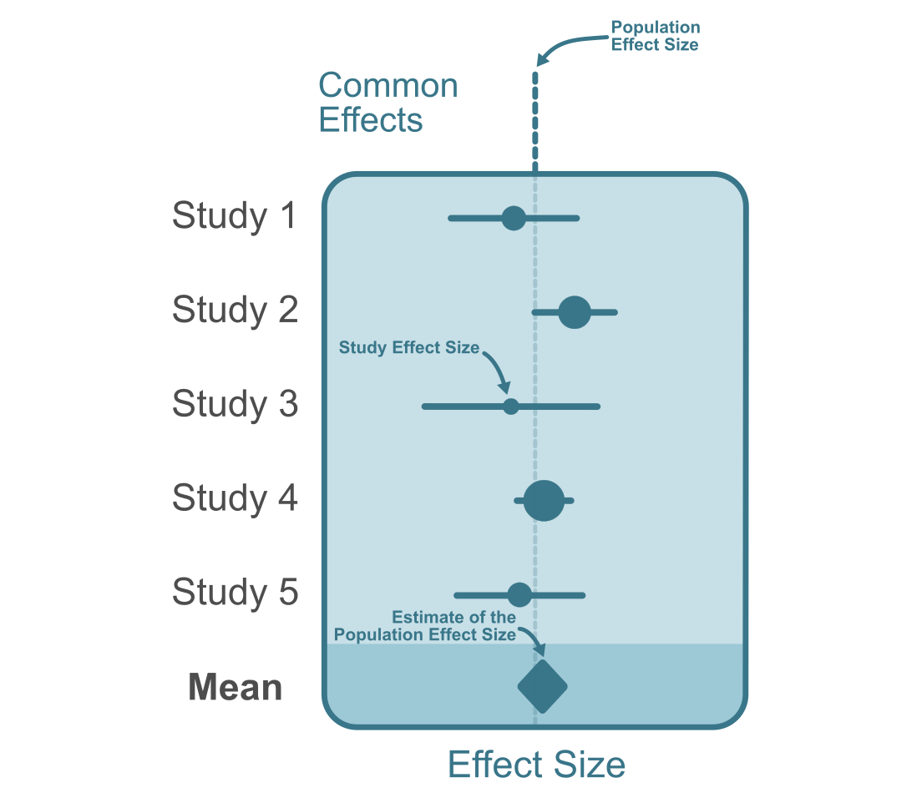
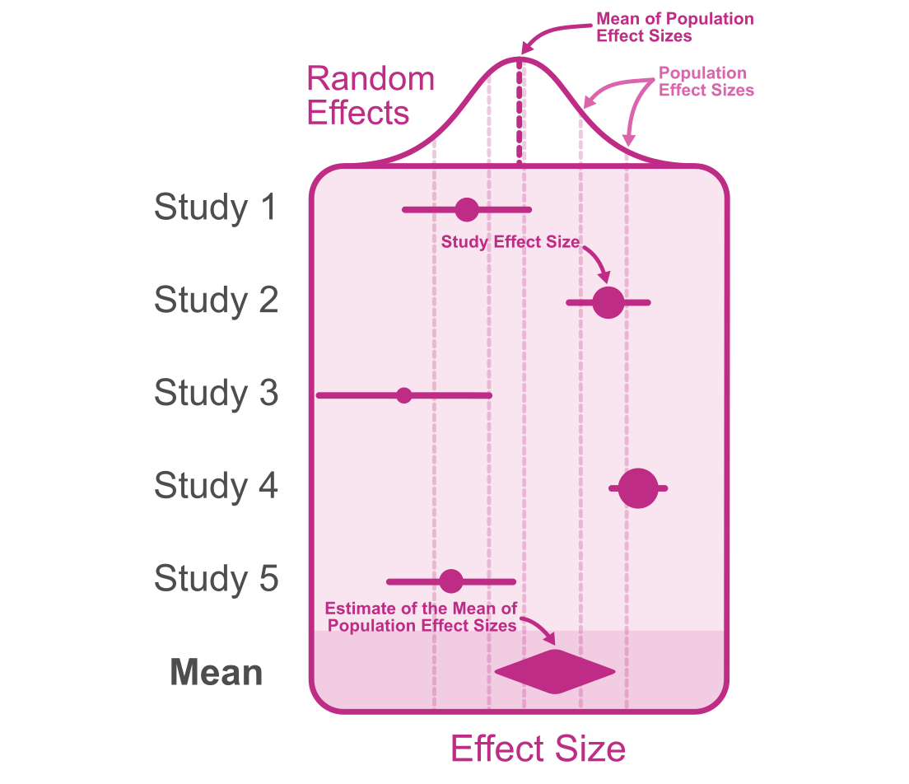
We suppose that the whole heterogeneity is still random
Jané, M. B. (2024). Artifact Corrections for Effect Sizes: Seeing Reality for What It Is. https://matthewbjane.quarto.pub/artifact-corrections-for-effect-sizes/
Real effect -> Effect in the literature​

Slide 7
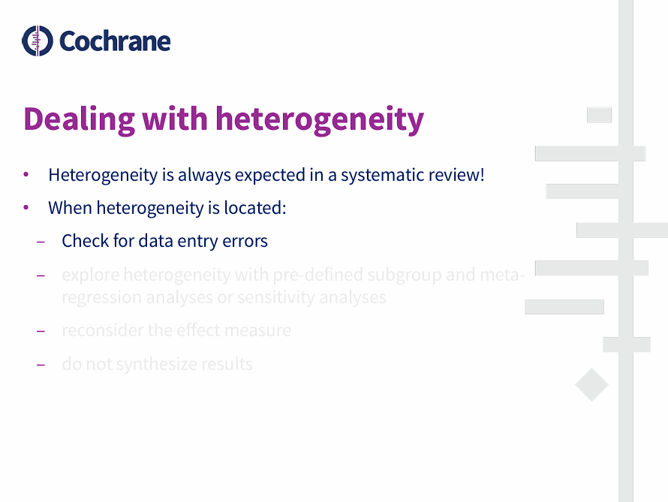
Explore heterogeneity with pre-defined subgroup, meta regression or sensitivity analyses.
Reconsider the effect measure
Do not synthesize results

Slide 8
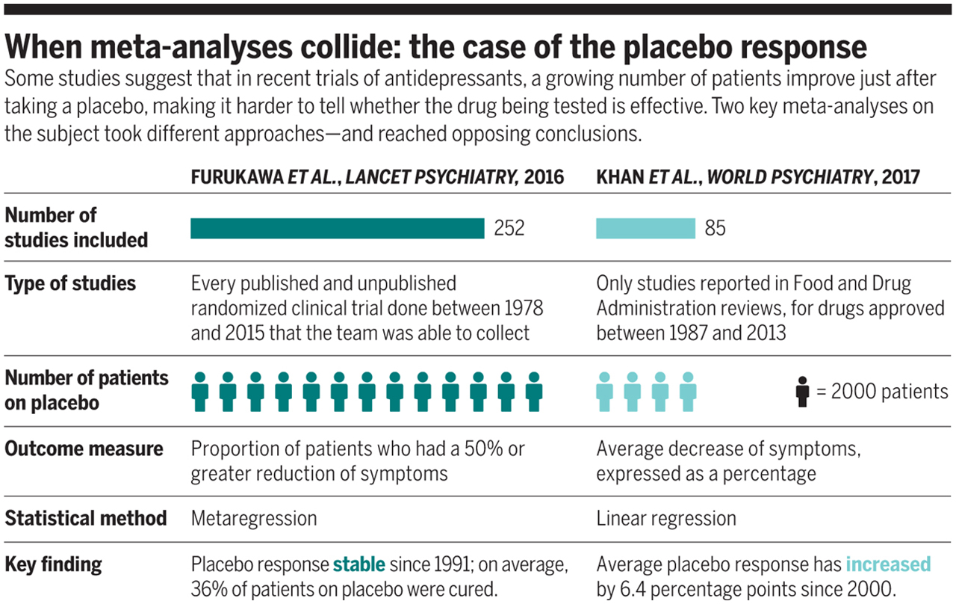
However, problems happened
Meta-analyses contradict with each others
de Vrieze, J. (2018). The metawars. Science, 361(6408), 1184–1188. https://doi.org/10.1126/science.361.6408.1184

Slide 9
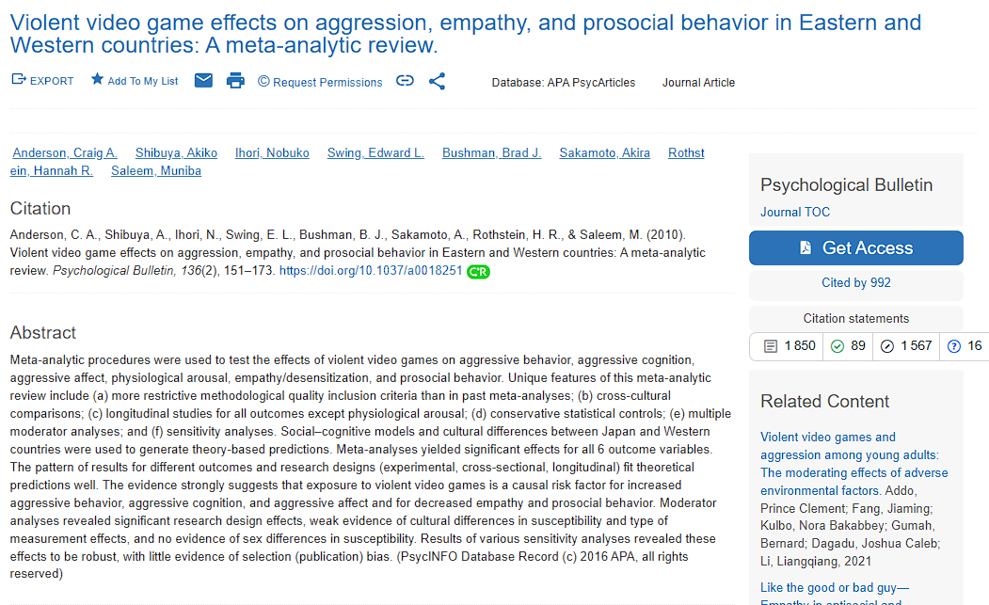
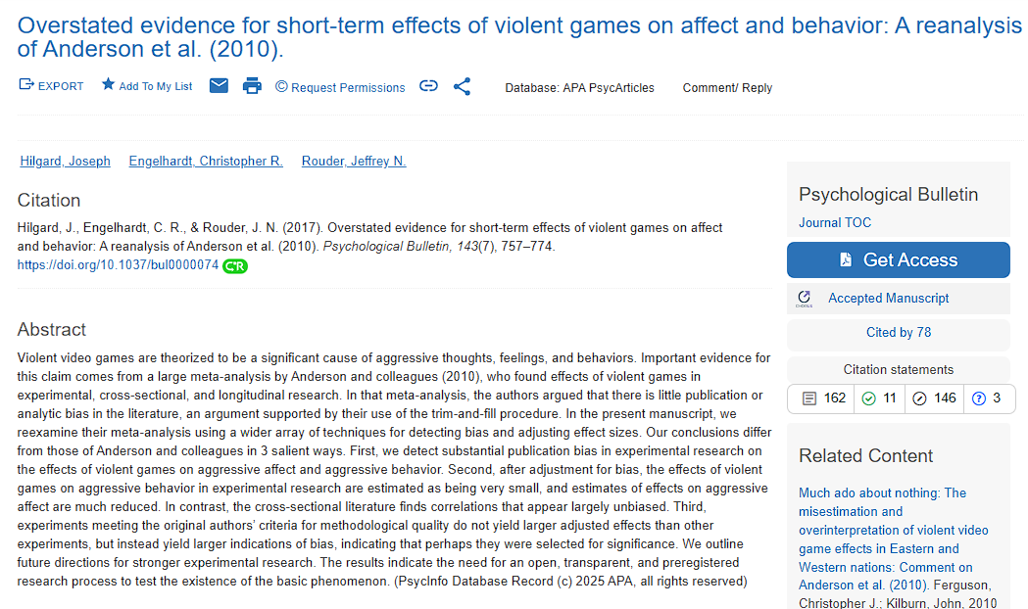
However, problems happened
Meta-analyses contradict with each others
v
v

Slide 10
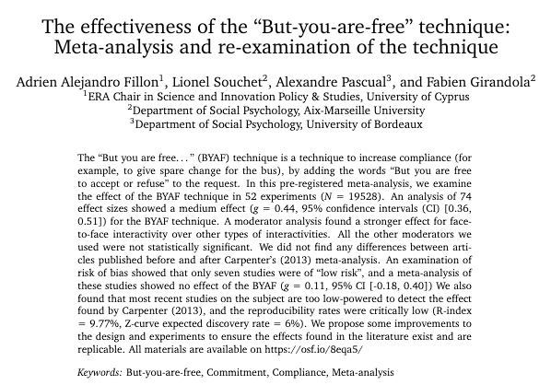
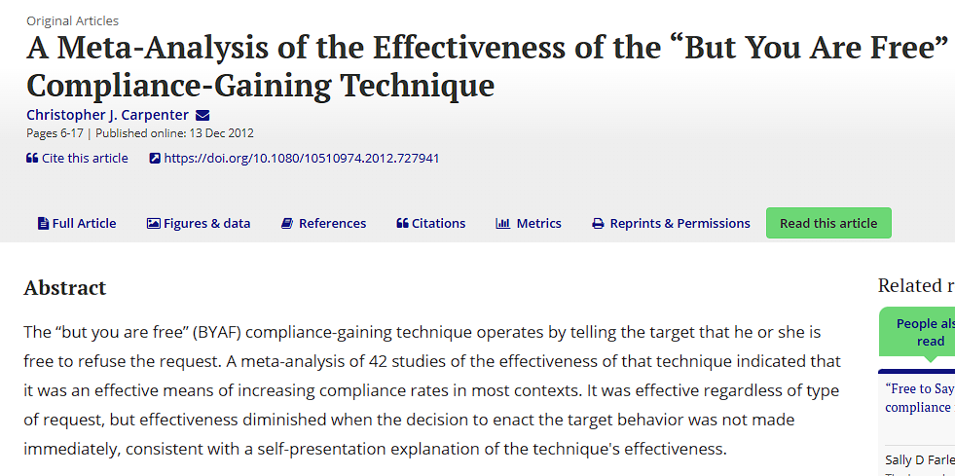
However, problems happened
Meta-analyses contradict with each others
v
v

Slide 11
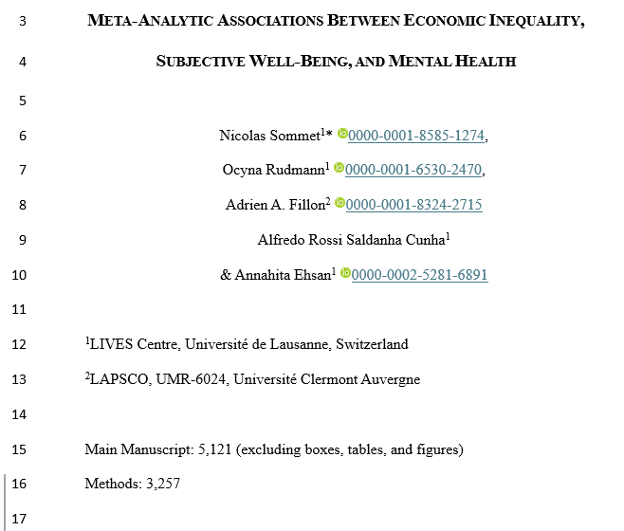
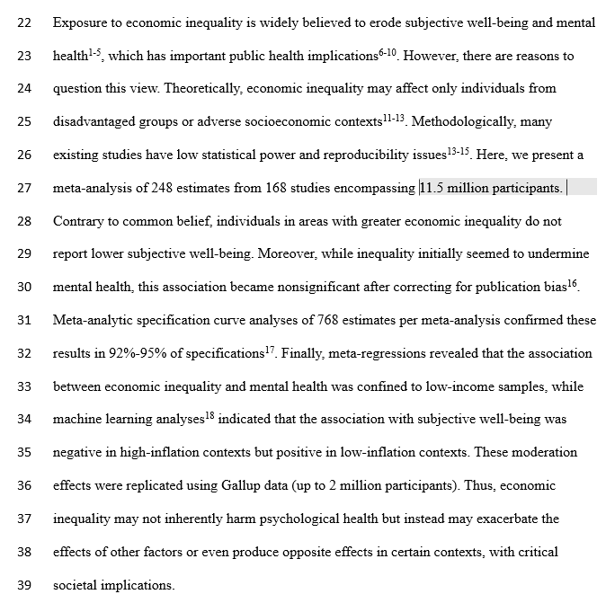
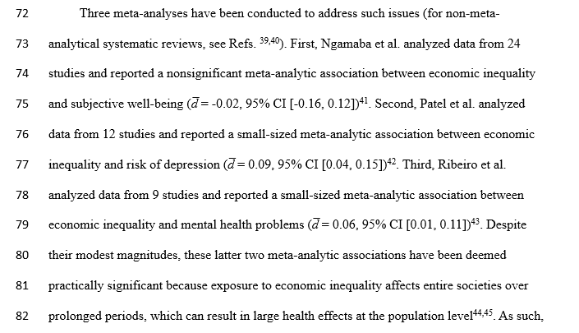
However, problems happened
Meta-analyses contradict with each others
v
v

Slide 12
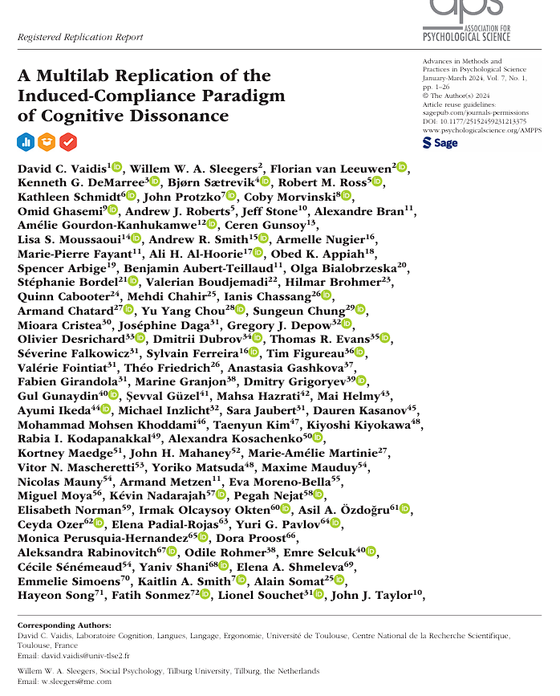

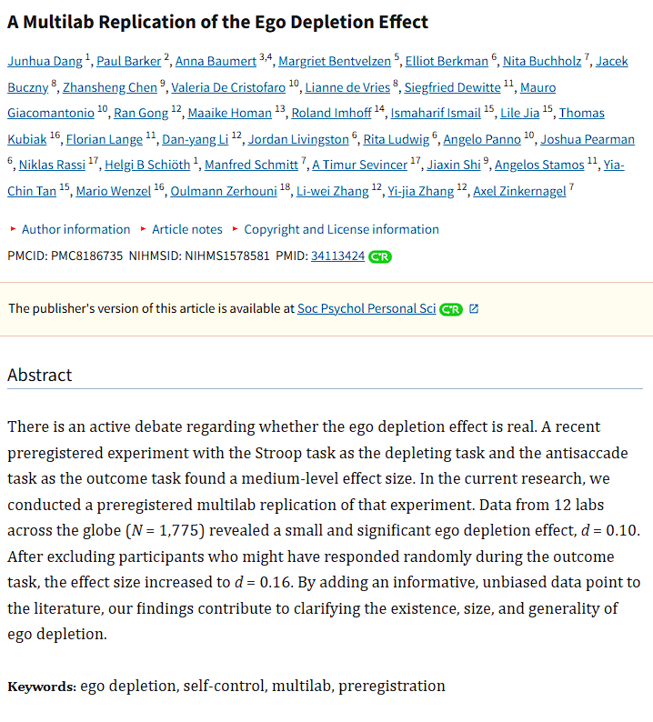
However, problems happened
Meta-analyses contradict with each others
Meta-analyses contradict multilab-analyses

Slide 13
However, problems happened
Lewis Molly, Mathur Maya B., VanderWeele Tyler J. and Frank Michael C. (2022) The puzzling relationship between multi-laboratory replications and meta-analyses of the published literature
R. Soc. Open Sci.9211499
http://doi.org/10.1098/rsos.211499
Meta-analyses contradict with each others
Meta-analyses contradict multilab-analyses
Why ?
Heterogeneity in the included studies
15 multi-lab replications
15 meta-analyses
Publication biases
12 effect sizes are significantly different
Standardisation in multilab
On average, meta-analytic effect sizes are almost three times as large as replication effect sizes.
Kvarven, A., Strømland, E. & Johannesson, M. Comparing meta-analyses and preregistered multiple-laboratory replication projects. Nat Hum Behav 4, 423–434 (2020). https://doi.org/10.1038/s41562-019-0787-z
Unknown factors

Slide 14
However, problems happened
Meta-analyses contradict with each others
Meta-analyses contradict many-analyses

Slide 15
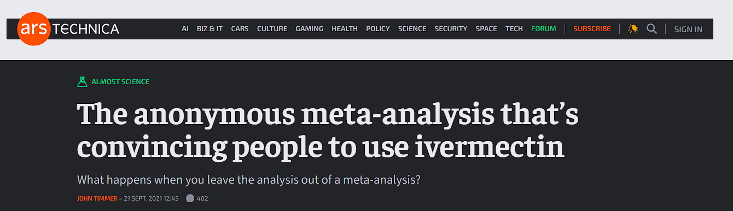
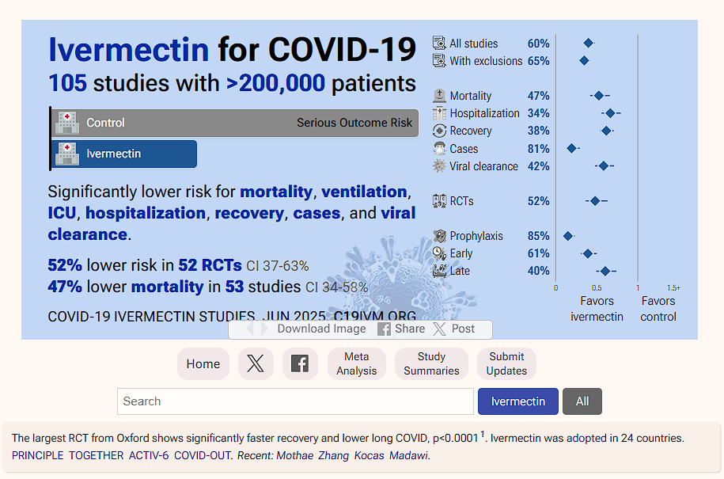
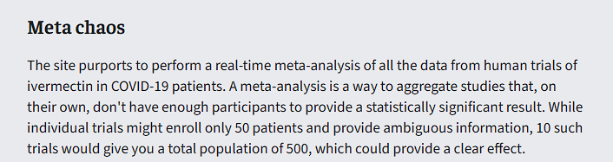
However, problems happened
Meta-analyses contradict with each others
Meta-analyses contradict many-analyses
Meta-analyses contradict common knowledge

Slide 16
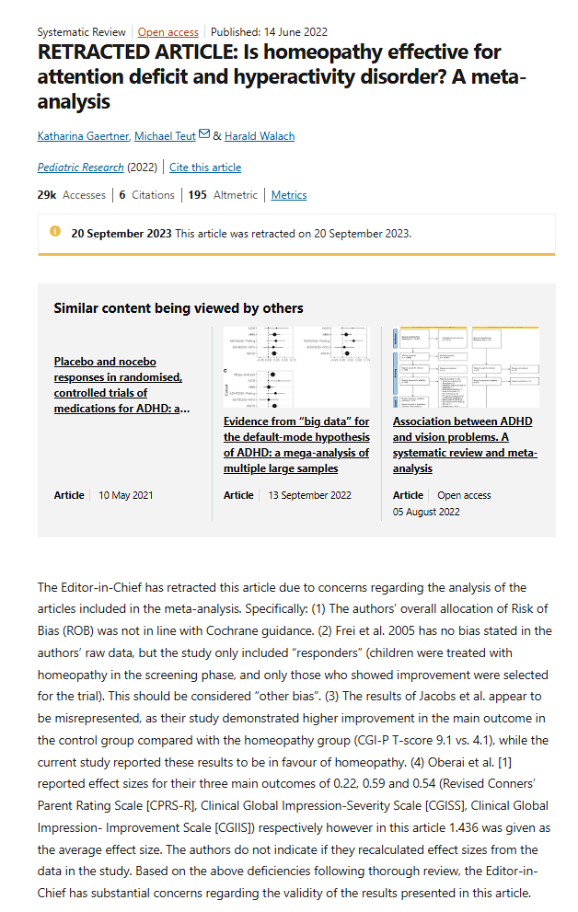
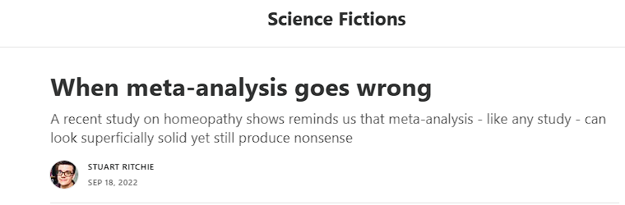
However, problems happened
Meta-analyses contradict with each others
Meta-analyses contradict many-analyses
Meta-analyses contradict common knowledge
Was pre-registered, making sure that all the criteria and rules for handling the data were set out in advance;
Had a fairly clear set of inclusion and exclusion criteria and a nice flowchart to illustrate which studies were and weren’t analysed and why;
Assessed the quality and “risk of bias” of each of the included studies using two separate checklists: the one used by the Cochrane Collaboration, and another one;
Used the “GRADE guidelines” to assess the strength of the evidence;
Included a test of the heterogeneity of the studies;
Included a publication bias test;
Is Open-Access, so anyone can read it.

Slide 17
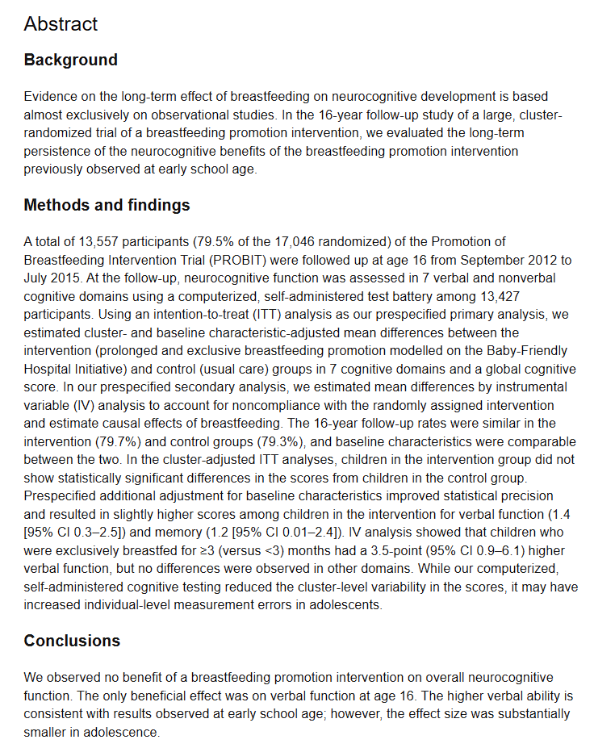
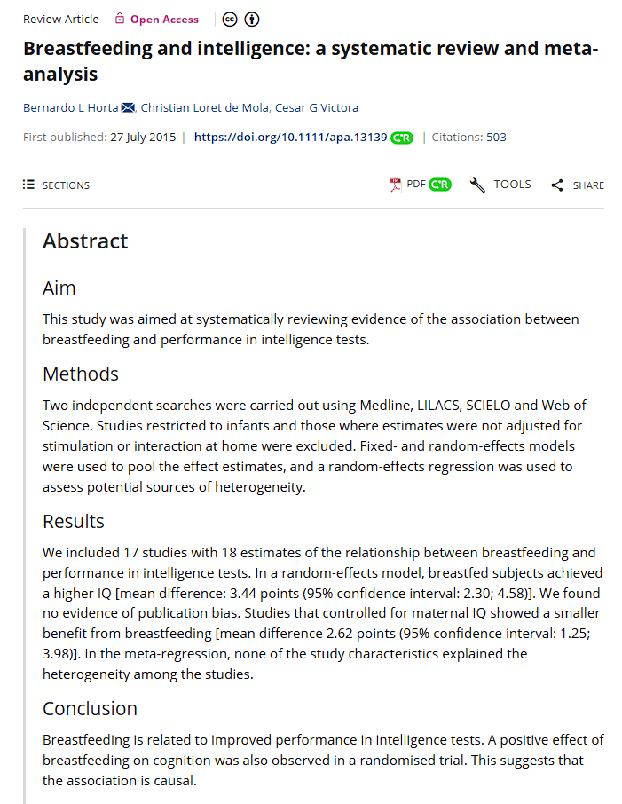
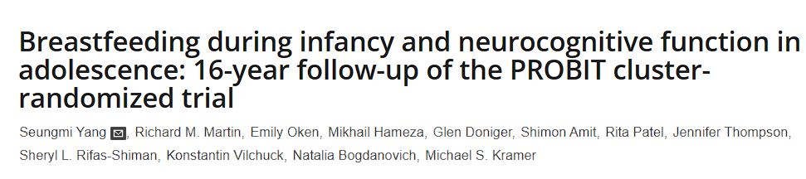
However, problems happened
Meta-analyses contradict with each others
Meta-analyses contradict many-analyses
Meta-analyses contradict common knowledge
Notes:
Probit is the only RCT on the subject

Slide 18
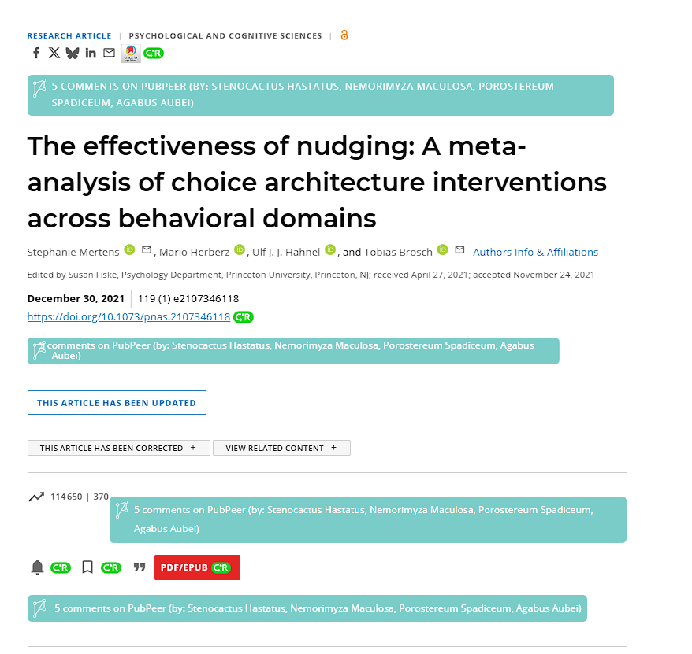


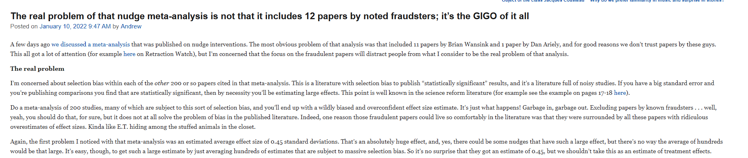
However, problems happened
Meta-analyses contradict with each others
Meta-analyses contradict many-analyses
Meta-analyses contradict common knowledge
Notes:
Garbage in garbage out
Nudge is not a homogeneous construct.

Slide 19
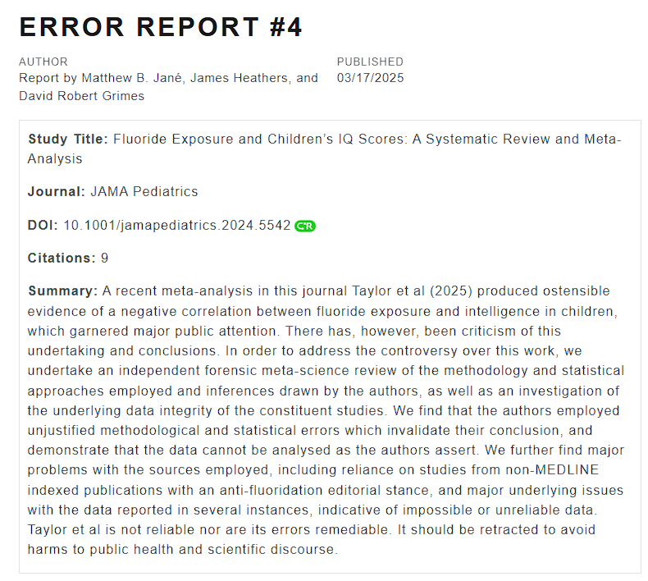
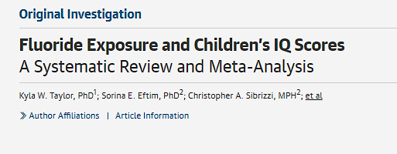
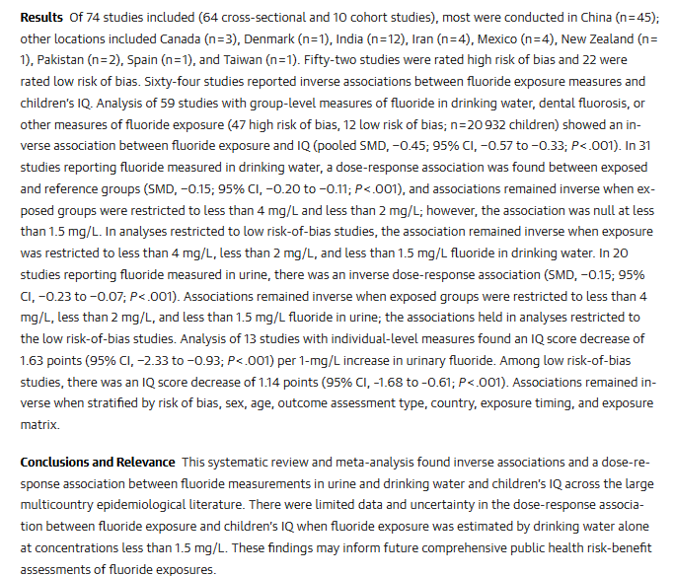
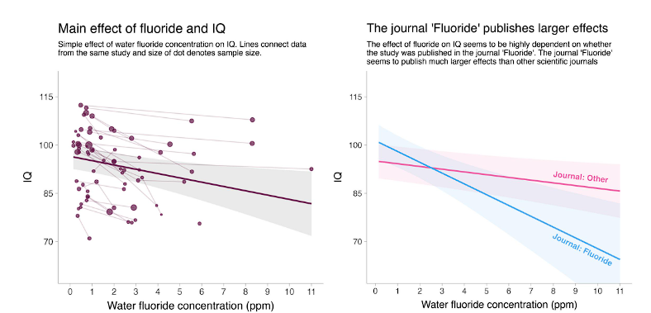
However, problems happened
Meta-analyses contradict with each others
Meta-analyses contradict many-analyses
Meta-analyses contradict
common knowledge

Slide 20
Why?
The too high prevalence of publication bias
Meta-analysis analyses only the published literature (or the tracable literature)
Selection of false positives
Hiding of true negatives

Slide 21
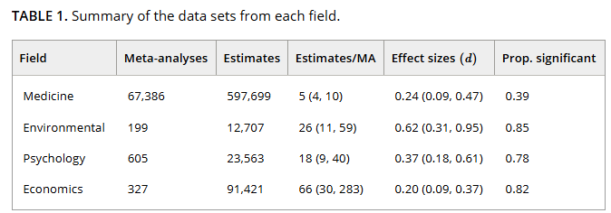

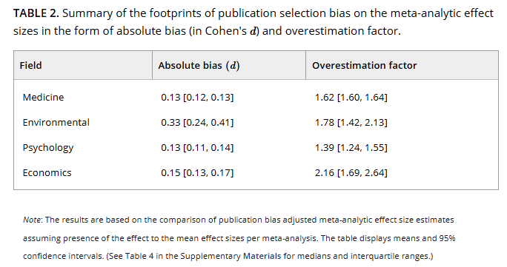
Bartoš, F., Maier, M., Wagenmakers, E., Nippold, F., Doucouliagos, H., Ioannidis, J. P. A., Otte, W. M., Sladekova, M., Deresssa, T. K., Bruns, S. B., Fanelli, D., & Stanley, T. D. (2024). Footprint of publication selection bias on meta‐analyses in medicine, environmental sciences, psychology, and economics. Research Synthesis Methods, 15(3), 500–511. https://doi.org/10.1002/jrsm.1703
6 models adjusting for publication biases + PET-PEESE
Notes:
EVIDENCE INFLATION FACTOR

Slide 22
Why?
The large degree of freedom from meta-analysts
The lack of transparency of meta-analyses who overgeneralize the tested effect

Slide 23
Sandoval-Lentisco, A., Tortajada, M., Lopez-Nicolas, R., López-López, J., Wagenmakers, E., Sánchez-Meca, J., & Hardwicke, T. E. (2024, May 13). Preregistration of psychology meta-analyses: A cross-sectional study of prevalence and practice. https://doi.org/10.31222/osf.io/627a4
1403 meta-analyses in psychology published in 2021
382 (27%) were preregistered​
PRISMA – 23 decisions​​
Median of 13 decisions covered​​​
Out of these 13, all meta-analyses had at least one deviation​​​​
Median of 8 deviations undisclosed​​​

Slide 24
Why?
The difficulty to conduct meta-analyses and the lack of proper training

Slide 25
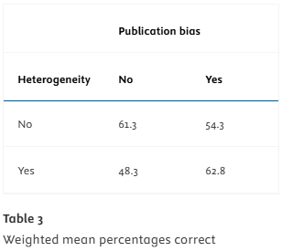
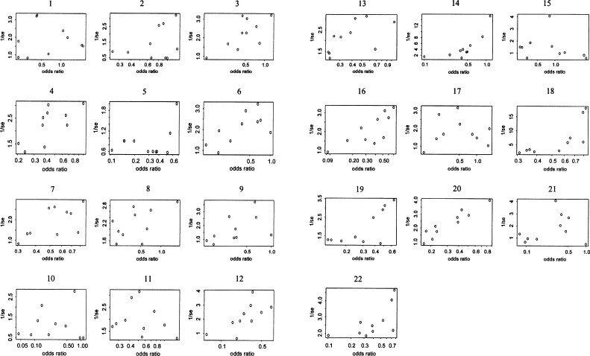
For each of the following plots, please place an “X” in front of the response that best fits your interpretation of whether there is evidence for publication bias: “yes,” “no,” or “maybe.”
Terrin, N., Schmid, C. H., & Lau, J. (2005). In an empirical evaluation of the funnel plot, researchers could not visually identify publication bias. Journal of Clinical Epidemiology, 58(9), 894–901. https://doi.org/10.1016/j.jclinepi.2005.01.006
Notes:
No publication bias = seen

Slide 26
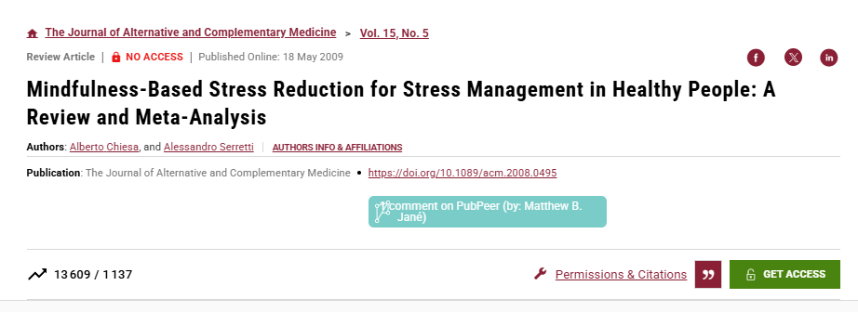
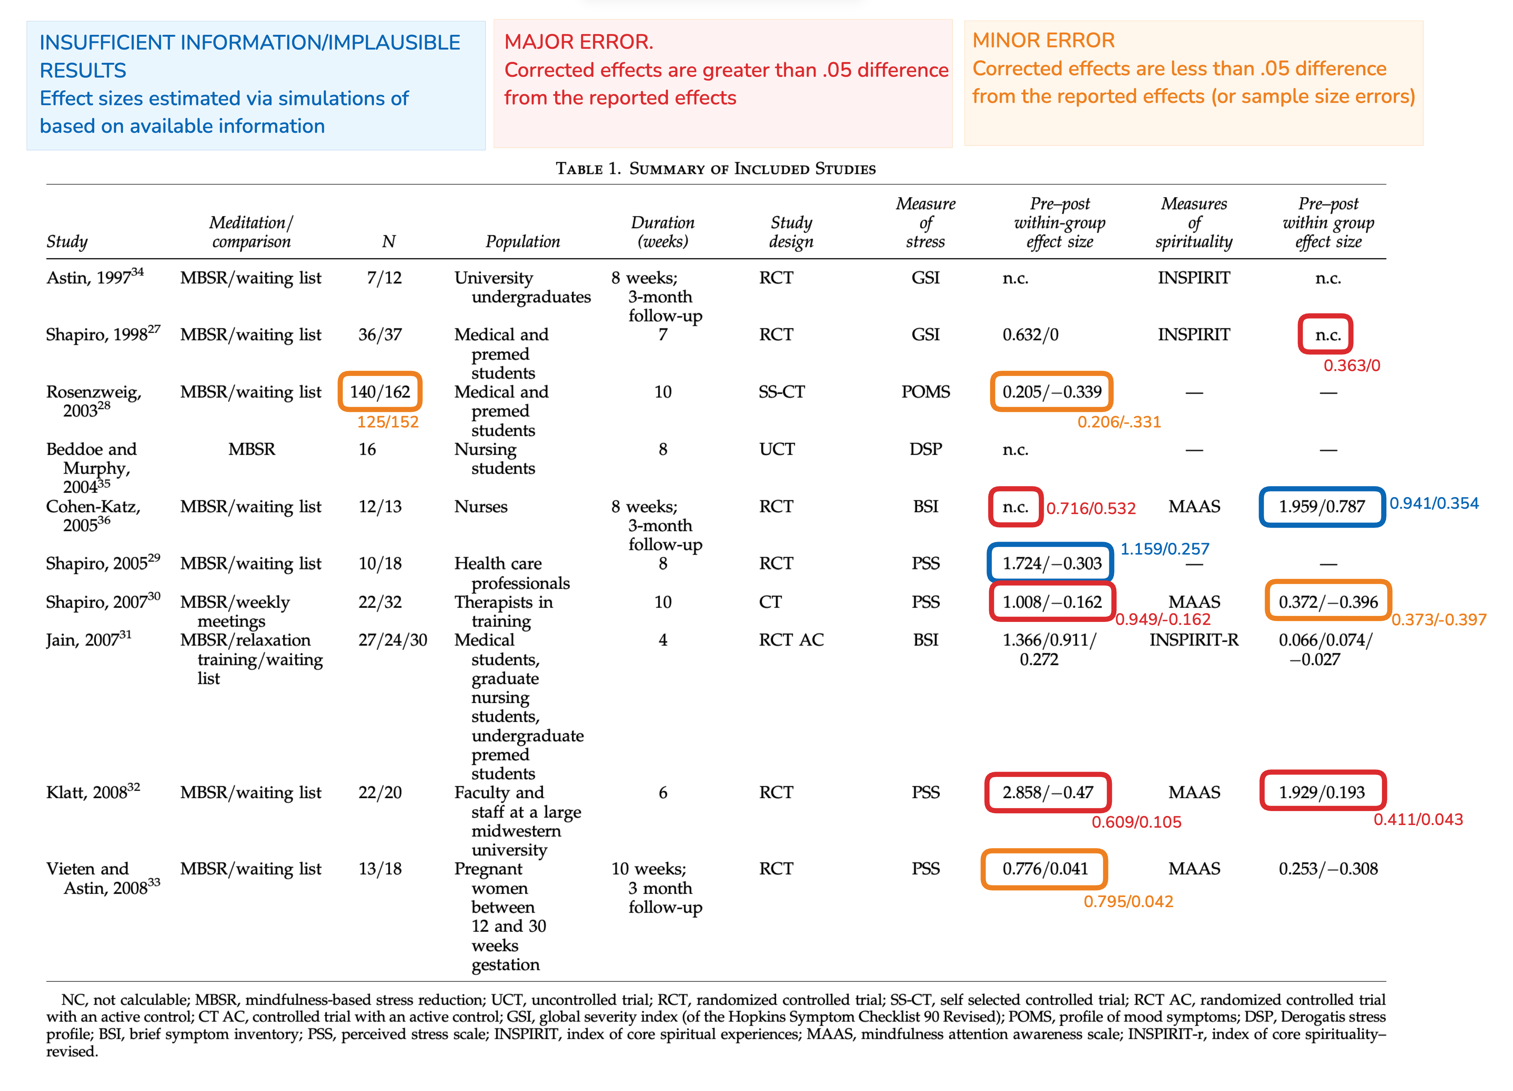
Chiesa, A., & Serretti, A. (2009). Mindfulness-Based Stress Reduction for Stress Management in Healthy People: A Review and Meta-Analysis. The Journal of Alternative and Complementary Medicine, 15(5), 593–600. https://doi.org/10.1089/acm.2008.0495
Error Report #1
Matthew B. Jané

Slide 27
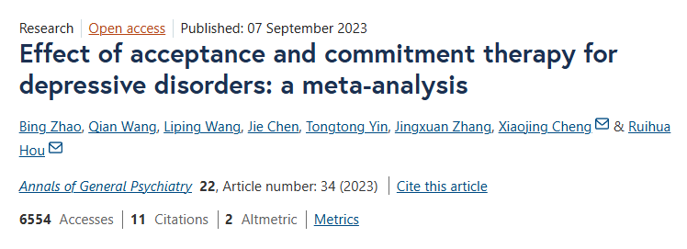
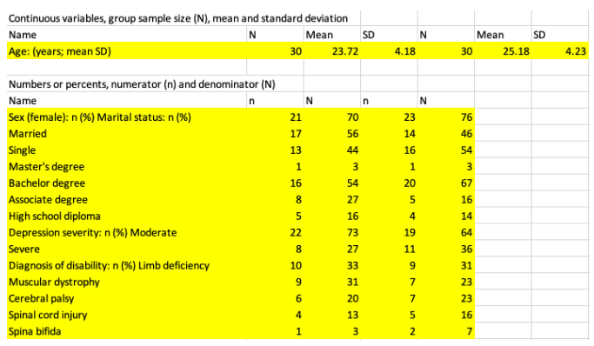
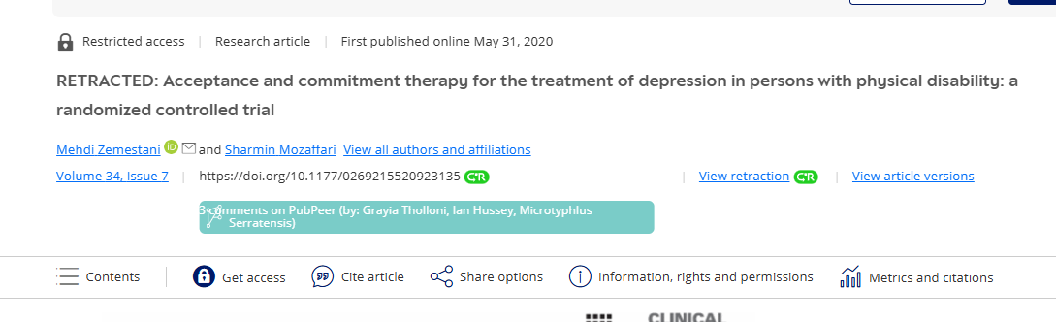
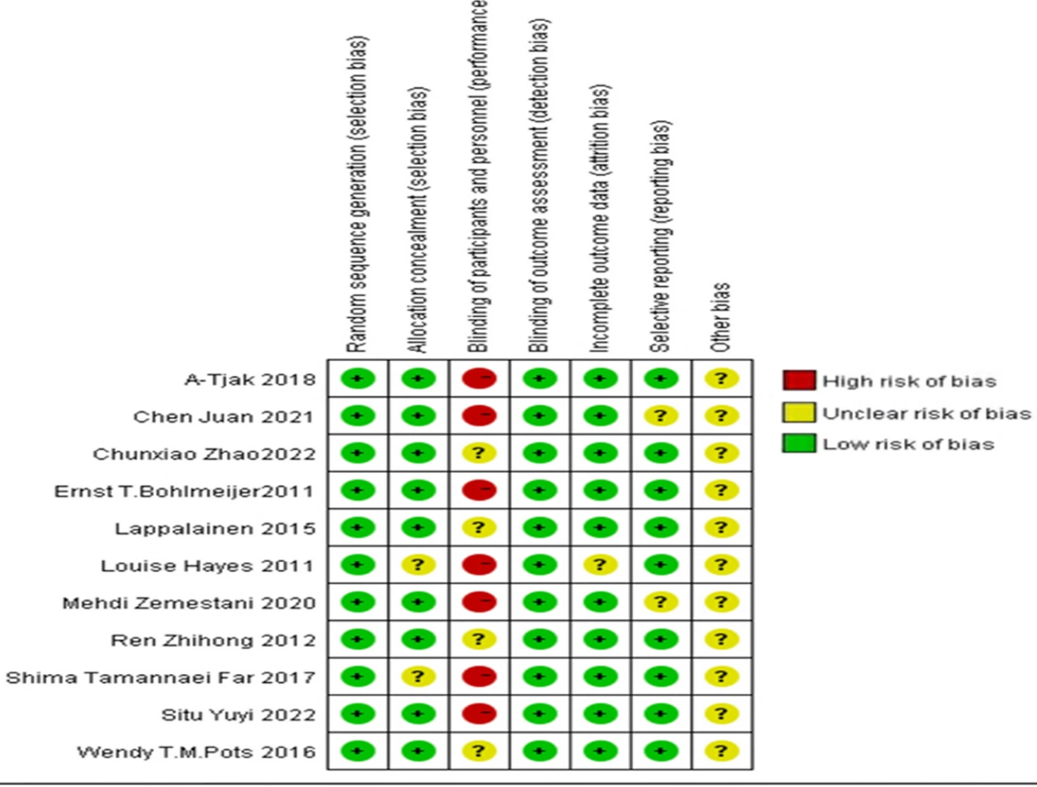
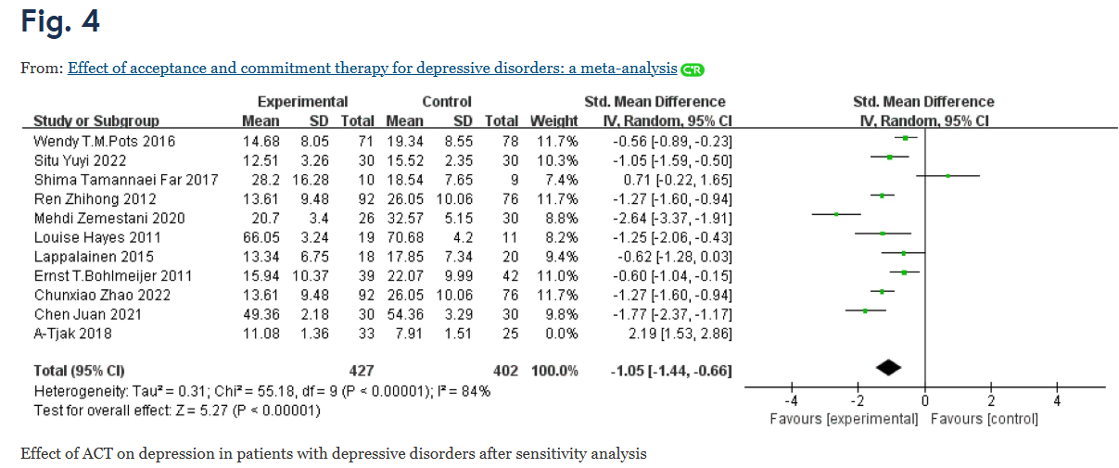
Means for both conditions were mathematically impossible
For age, and for BDI (depression) for all 3 time points
SD for both conditions were mathematically impossible
For age, and for BDI (depression) for all 3time points
T-values reported are inconsistent with means and sds reported
It leads to an impossible effect size of cohen's d = 2.62

Slide 28
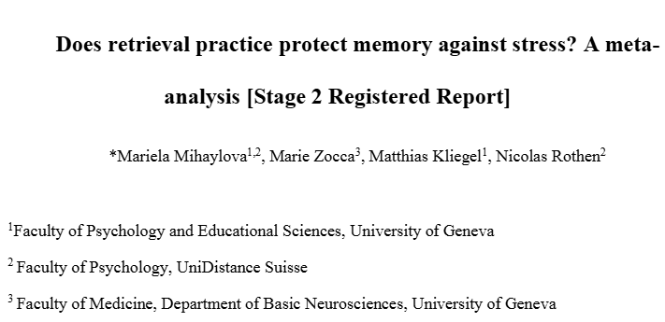
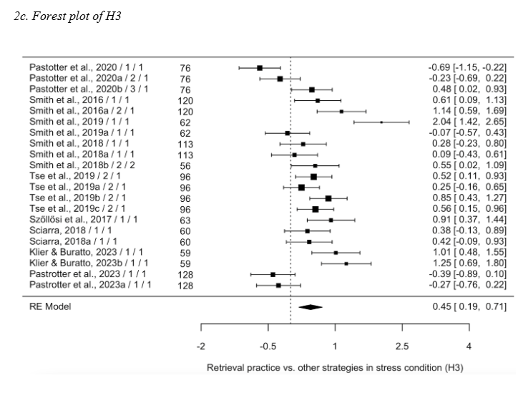
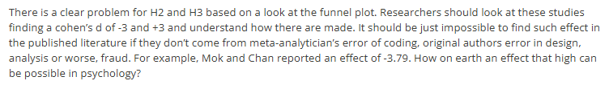
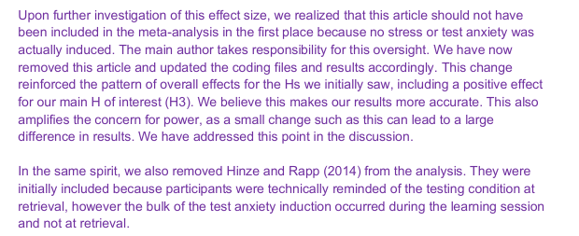

Slide 29
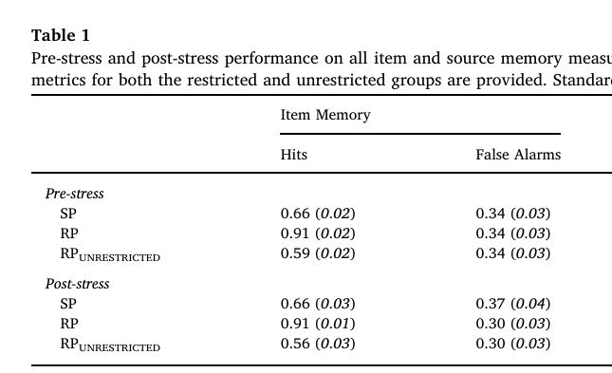
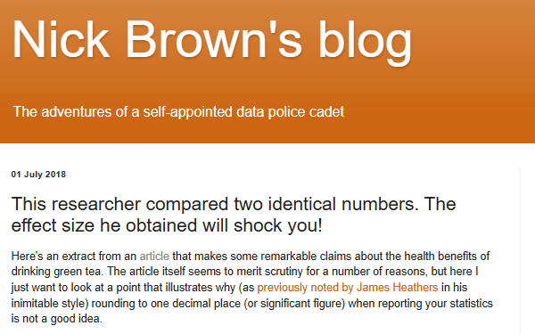
SE = SD/sqrt(n).
Cohen's d = (M₂ - M₁) ⁄ SD_{pooled}
SD = 0.03xsqrt(32) = 0.1643
Cohen's d = 2.03
SD = 0.01xsqrt(30) = 0.05656
SDrplow = 0.005001xsqrt(32) = 0.02829
SDrphigh = 0.0149999xsqrt(32) = 0.08484
SDptclow = 0.025001xsqrt(30) = 0.13693
SDptchigh = 0.0349999xsqrt(30) = 0.191697
Cohen's d = 2.53
Cohen's d = 1.68

Slide 30
Notes:
We are supposed to look at the effect of RP on stress but clearly we are not as there are literaly no effect based on stress for both. Only change in dispersion.
Again, decisions to extract the data lead to a highly positive effect, while another would have resulted in no effect at all.

Slide 31
Why?
Negligence that can be voluntary/conflict of interest

Slide 32
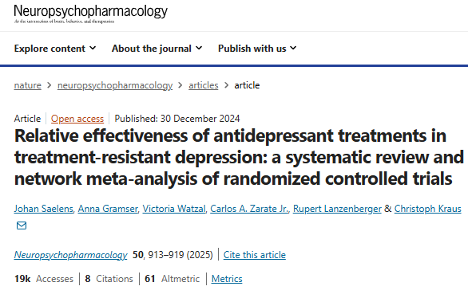

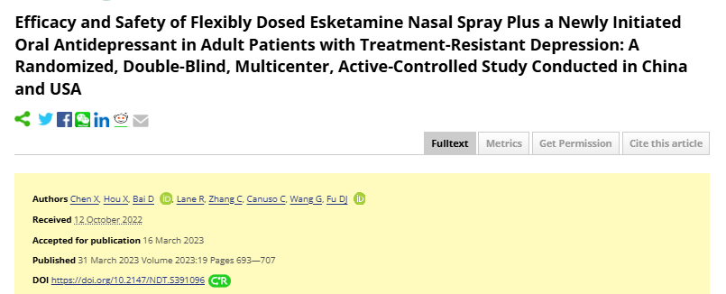
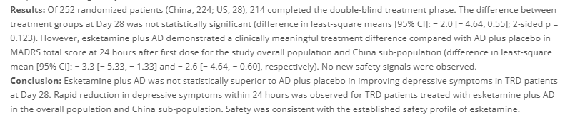
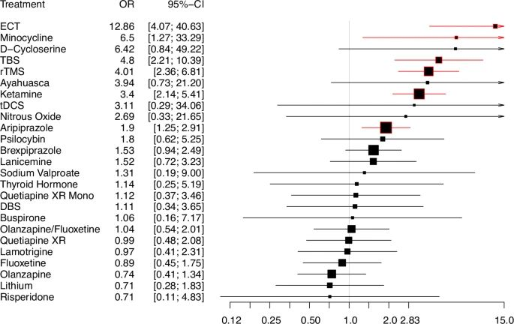


Slide 33
It’s time we downgraded meta-analyses in our mental hierarchy of evidence. At the very least we shouldn’t be particularly impressed at the mere mention of a meta-analysis, until we’ve judged each one on its merits. Despite their reputation, there’s nothing magical about meta-analyses: they’re just studies like everything else. And, like everything else in science—to a greater or lesser extent—they’re fucked.

Slide 34




Where does it lead to?
Increased risk for population

Slide 35
Where does it lead to?
O’Connell, N., Moore, R. A., Stewart, G., Fisher, E., Hearn, L., Eccleston, C., Wewege, M., & De C Williams, A. C. (2023). Trials We Cannot Trust: Investigating Their Impact on Systematic Reviews and Clinical Guidelines in Spinal Pain. The Journal of Pain, 24(12), 2103–2130. https://doi.org/10.1016/j.jpain.2023.07.003
Increased risk for population
8 untrustworthy trial on spinal pain
Used in 32 reviews and meta-analyses
None raised concerns about them
In meta-analyses, deleting these trials reduced the effect size by 58%
9/10 of reviews drawn recommendations based on these trials

Slide 36

Where does it lead to?
Xu, C., Fan, S., Tian, Y., Liu, F., Furuya-Kanamori, L., Clark, J., Zhang, C., Li, S., Lin, L., Chu, H., Li, S., Golder, S., Loke, Y., Vohra, S., Glasziou, P., Doi, S. A., & Liu, H. (2025). Investigating the impact of trial retractions on the healthcare evidence ecosystem (VITALITY Study I): retrospective cohort study. BMJ, 389, e082068. https://doi.org/10.1136/bmj-2024-082068
Increased risk for population
1330 retracted trials – 847 systematic reviews that
included them + 3902 meta-analyses
3 guidelines from the English Health institute used these meta-analyses in their decisions.
Notes:
Figure 2 shows the impact of retracted trials on the results of meta-analyses (n=3902). We found that the exclusion of the retracted trials from the meta-analyses led to a change in the direction of the pooled effect in 8.4% (95% confidence interval (CI) 6.8% to 10.1%; n=392) of the meta-analyses, and a change in the significance of the P value occurred in 16.0% (14.2% to 17.9%; n=692). The proportion of meta-analyses in which both the direction of the effects and the significance of the P value were altered was 3.9% (95% CI 2.5% to 5.2%; n=218), and the proportion of meta-analyses in which either the direction of the effects or the significance of the P value was altered was 20.6% (18.5% to 22.8%; n=866). In 15.7% (95% CI 13.5% to 17.9%; n=659) meta-analyses, the magnitude of the effects changed by more than 50% when retracted trials were excluded.

Slide 37



Slide 38
My proposition: redefine the purpose of meta-analysis
Meta-analyses should not, by any means, be seen as a tool to estimate an effect size
Therefore, they should not be used in recommendations, or guidance, without a clear understanding of each specific study included

Slide 39
Meta-analysis is an important tool to flag potential outliers in a given literature, understand why they are outliers and how they appeared in the literature
Using this understanding, it can provide guidance on how to improve new studies in terms of design and protocol
At the bare minimum, it can help detect false effects in single studies (detect retracted studies – impossible effect sizes – studies lacking crucial information)
The most important part of a meta-analysis is the qualitative risk of bias analysis. In most studies, meta-analysts do not explain why they coded their risk of bias the way they coded it!

Slide 40





Slide 41


72 checks (inspect-SR questions)
59 RCTs​
50 cochrane reviews​​
25% of RCTs had moderate concerns for authenticity and 6% serious concerns​​​
Removing them, 22% of the reviews had NO RTCs at all.​​​​
No relationship between inspect-SR and ROB2 (the Cochrane Risk of bias tool)​​​​​
However, many checks proved difficult to understand or implement, which may have led to unwarranted skepticism in some instances.​​​

Slide 42
From "let's see how the literature leads to a specific effect"
To
"let's see if we can trust at least a little bit the literature"

